Slide 1


Slide 2
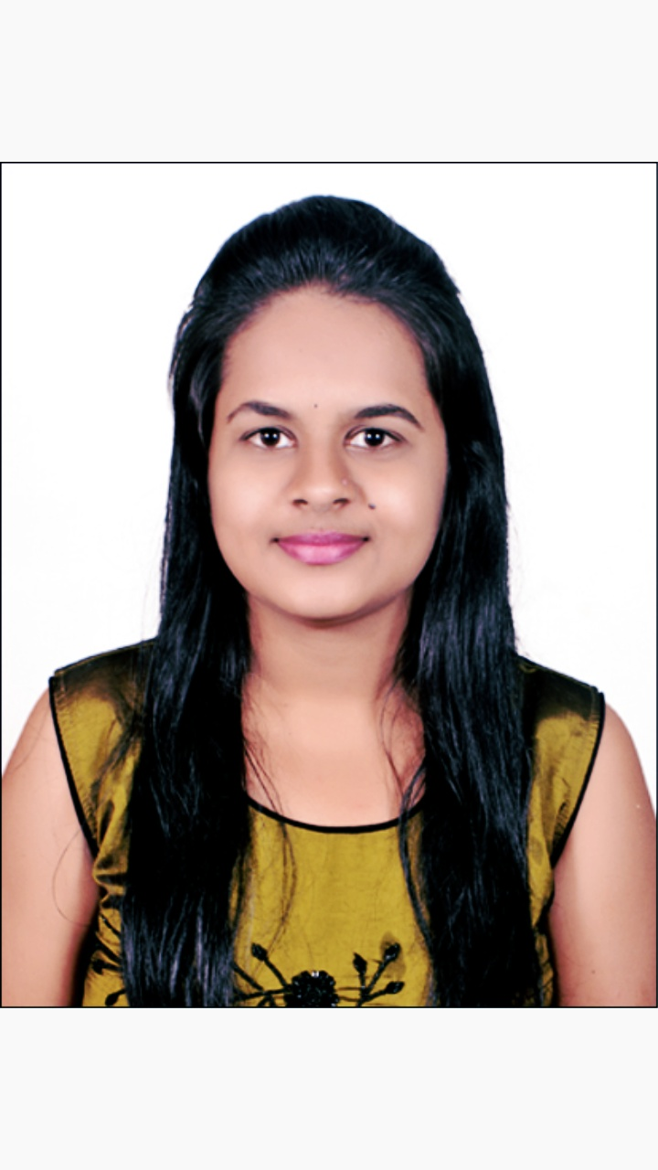
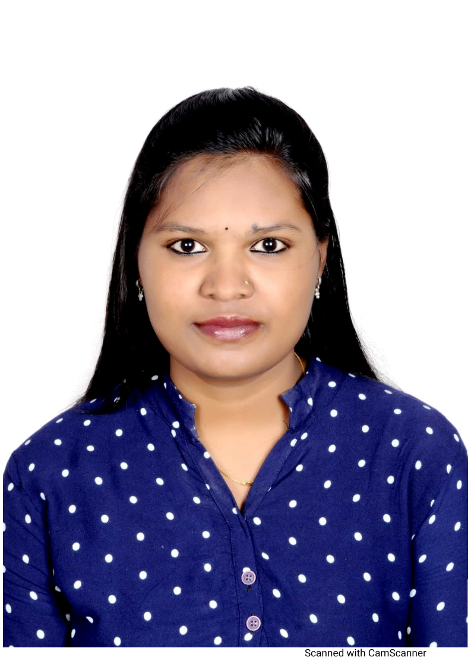
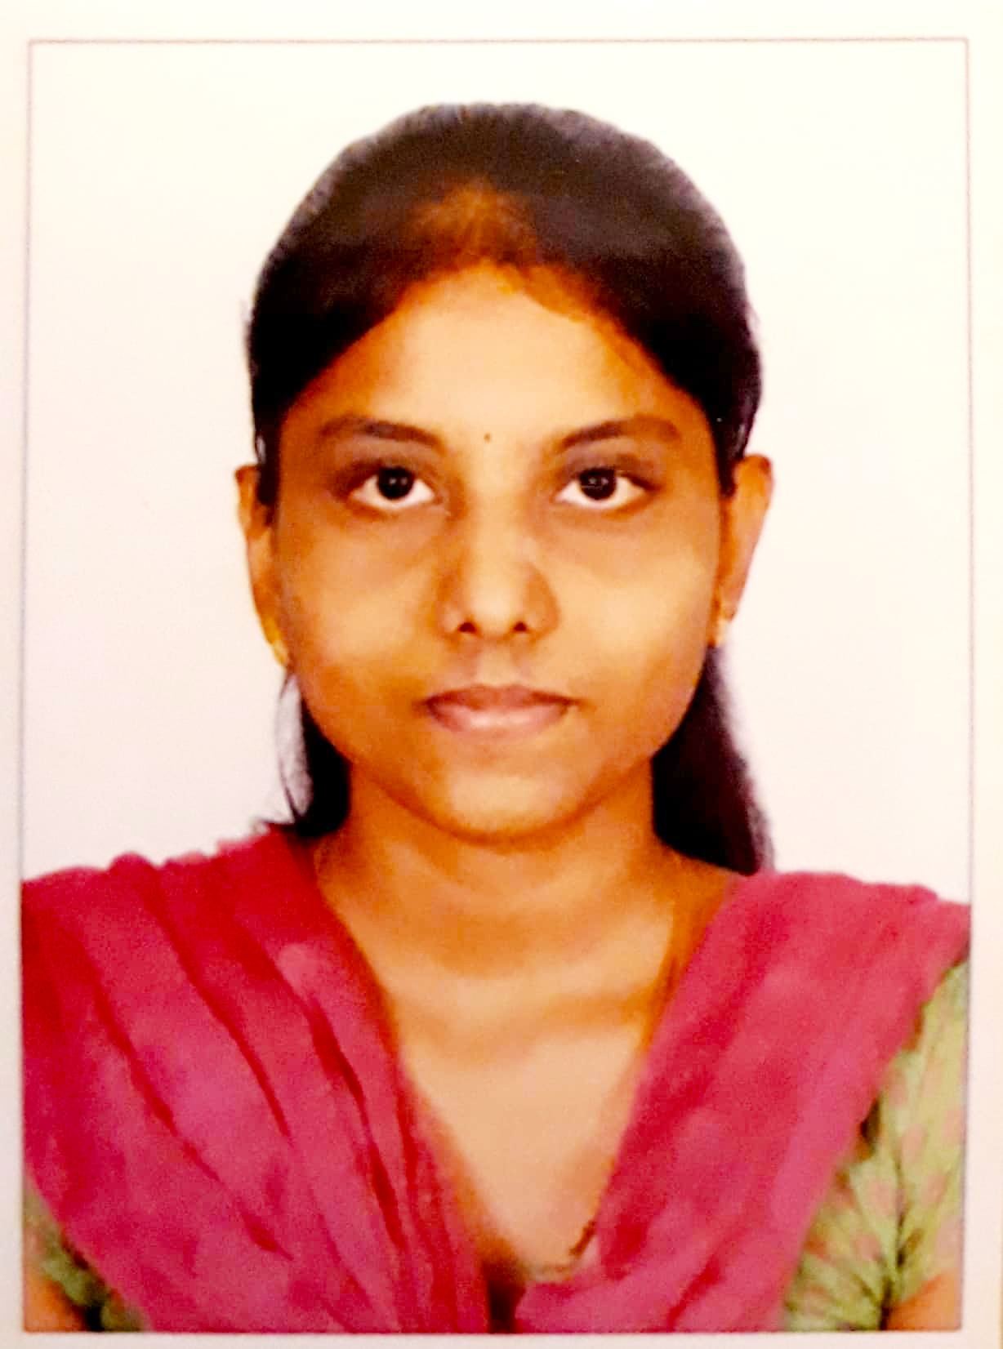
Project Highlights
Project Name :Top Women Chess Players Analysis
Team Size : 3
BU Mentor Name : Samyuta ,Jagdish Prasad Sahu, Hrushikeshava Reddy Mentor PS :20033200,20008728,996171
Hemalatha R
99002622
2009BLRMED01
B.E Computer science and Engineering
Asha N
99002646
2009BLRMED01
B.E Computer science and Engineering
Kavya K
99002567
2009BLRMED01
B.E Computer science and Engineering

Slide 3

Project Video Snippet

Slide 4
Future development that can be implemented further
This project can be implemented further by adding some other features like displaying the players personal details if we give their Name or ID.

Slide 5


Thank You !

